Slide 1
Dummy Variables

Slide 2
Typically we use linear regression with numerical data.
Number of square feet in a house
Population size of a city
Age of an individual
However, sometimes we wish to use categorical variables as predictor variables.
Eye color (e.g. “blue”, “green”, “brown”)
Gender (e.g. “male”, “female”)
Marital status (e.g. “married”, “single”, “divorced”)

Slide 3
When using categorical variables, it doesn’t make sense to just assign values like 1, 2, 3, to values like “single”, “married”, and “divorced”.
Instead, the solution is to use dummy variables. These are variables that we create specifically for regression analysis that take on one of two values: zero or one.

Slide 4
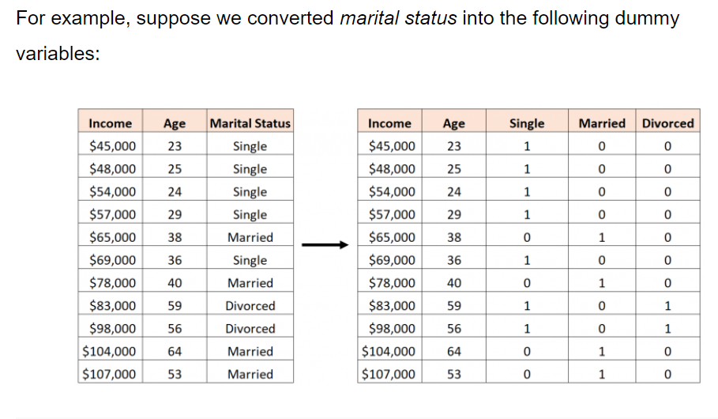
Having n dummy variables

Slide 5
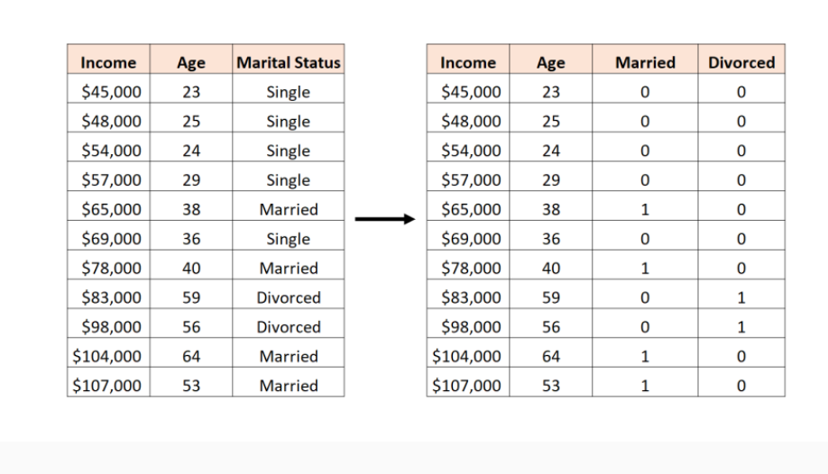
Having n-1 dummy variables

